Slide 1
V.A.S.T
Cyber Crusaders
Project Midterm Presentation

Slide 2
TABLE OF CONTENTS
01
INTRODUCTION
02
PRESENTATION
03
LIVE DEMO
04
FUTURE PLANS
Re-introduce our project idea and team members.
A more in-depth look at our progress thus far.
Demonstrate our application design and current features.
Timeline and plans for finishing our application.

Slide 3
01
INTRODUCTIONS (again)

Slide 4
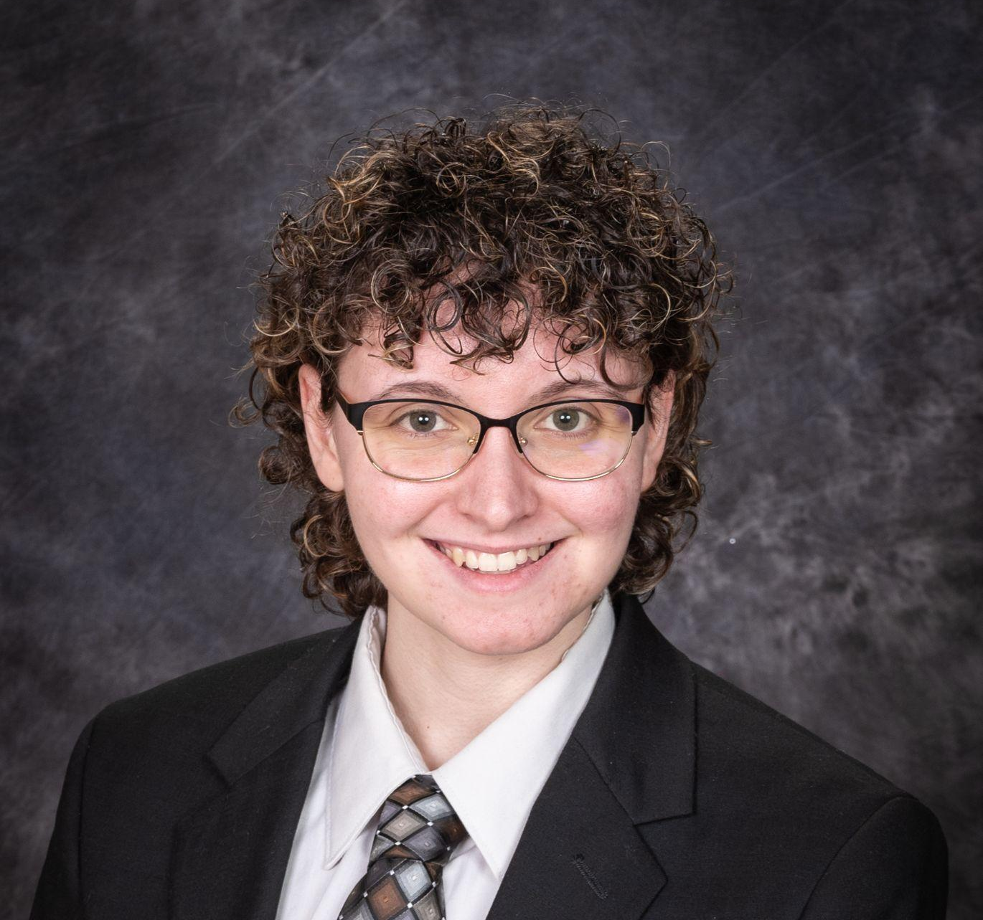

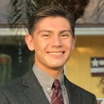


Our Team
“Crusading Towards a more Renewable Future”
Dani
DiTomasso
Daniel
Dorticos-Rossi
Eric
Carson
Yousif Moftah
Jordan
Oberstein
Front-End
Developer
Full-Stack
Developer
Back-End
Developer
Back-End
Developer
Back-End
Developer

Slide 5
Project Recap
Display Surface Skin Temperature and Wind Speed in the state of New York in an easy to understand fashion.
The user can draw their own conclusions as to where the best location to place renewable energy sources would be.
Part 1: Learning Modules will be available for K-12 educators to use as learning supplements
Part 2: Data Visualization components will allow users to explore data

Slide 6
02
CURRENT PROGRESS
What we’ve done so far and changes we’ve made.

Slide 7
Front-End Development
HTML/CSS
BOOTSTRAP
REACT/JAVASCRIPT
The main design of our application is in HTML and CSS.
In order to customize our website further than what bootstrap provides, the addition of “!important” was useful in overriding some of the predetermined CSS.
Bootstrap was utilized extensively to create our navbar, footer with all of NASA’s socials, and in the creation of our cards for the dynamic layout of our page.
React and Javascript were used to create the layout for our application elements found in the Surface Temperature Data page, the Wind Velocity Data page, and our Educational Resources page.
Notes:
Dani

Slide 8
Education Page
With guidance from NYS regents testing material and educator feedback, we have decided to make a renewable energy modules page which includes:
Key Renewable Energy terms
A fun module for students to visualize data
Notes:
Daniel

Slide 9
Data Exploration
Learning Modules supplemented with Data Visualization
Wind Velocity Data over 1 year
Surface Temperature Data over 1 year
Planned scope: New York State
Presented currently as slider component to display change over time
Allows for exploration of questions such as potential seasonal performance or intensity in different seasons
Notes:
Eric

Slide 10
Learning Modules
Inspiration from AP Environmental Science resources such as BioMan Biology to create interactive component
“Path of a Proton”
Path 1: Solar Energy
Path 2: Wind Energy
Division of difficulty by grade (K-6, 7-8, 9-12, AP Env Sci)
Notes:
Eric

Slide 11

Path
Demo
Notes:
Eric

Slide 12
03
LIVE DEMO

Slide 13
04
FUTURE PLANS
Where we plan to take our project from here.

Slide 14
MongoDB Database
Data for Educational Resources Page
We plan to build our own database and keep useful information, links, and learning modules for each category under our Educational Resources page for easy call access to our front-end.
Notes:
Dani

Slide 15
Express / Node API
Talk about development of API and how we will pull / use the data.
Key Renewable Energy terms
A fun module for students to visualize data

Slide 16
PROJECT TIMELINE
Final Presentation and demonstration
Database will be built
APR 15
APR 28
MAR 31
APR 22
API will be completed
Full integration of front-end to back-end
Notes:
Dani

Slide 17
THANK YOU!
Any Questions?

